Slide 1
Integrating siloed student data into a unified relational database
DS5110 Final Project
John Chung, Daniela Alejandra Gonzalez, Noah Rae-Grant

Slide 2
Introduction

Slide 3

Real-World Problem
Academy X seeks to analyze student outcomes using data from Admissions and College Counseling Offices. However, the data is siloed in separate spreadsheets.
What challenges arise when integrating data from both offices?
How can a relational database deliver high-value insights through queries and visuals?
Notes:
Our final project addresses a real-world challenge: creating a relational database for an educational institution that currently lacks a DBMS (database management system). The project is grounded in the specific needs and requests of an actual independent high school, referred to as "Academy X" in this report. Academy X aims to better understand trends in student outcomes by leveraging data from its Admissions Office and College Counseling Office.
This presentation will focus on the following questions:
What does the process of integrating data from both offices look like in practice?
What are some examples of SQL queries and visualizations that might provide actionable insights?

Slide 4
Database overview

Slide 5
Incoming student data in ADMISSION
Sending Middle Schools
Admission Office

Slide 6
Outgoing student data in COLLEGE
College Counseling
Universities

Slide 7

Data is siloed…
Admission Office
College Counseling

Slide 8
…but can be merged with a relational DB!
Admission Office
Students
College Counseling

Slide 9
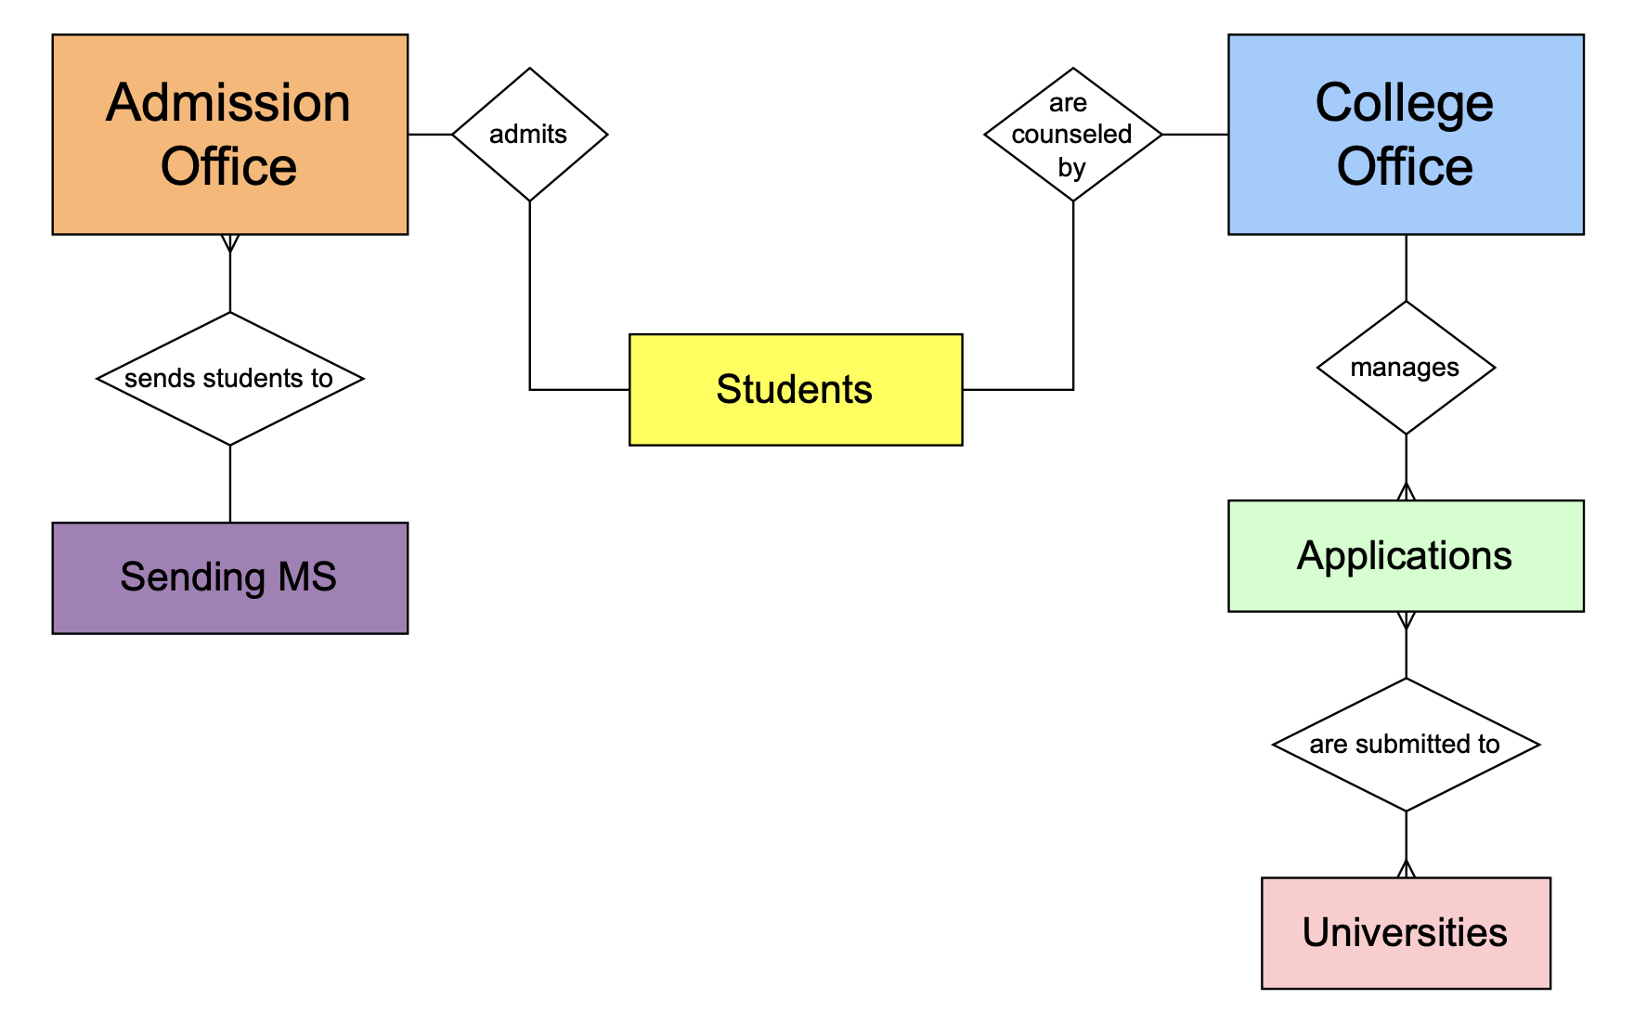
ERD (Relationships)

Slide 10
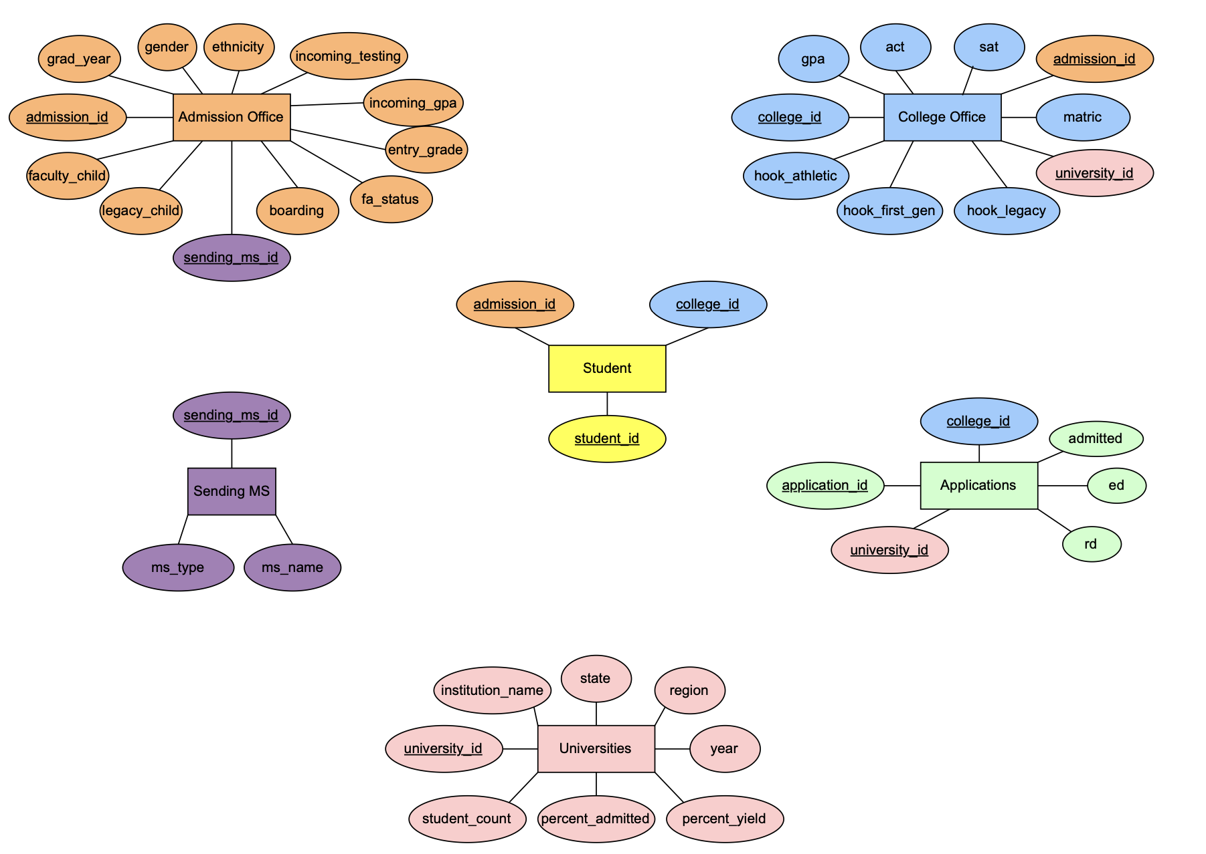
STUDENT provides links to all tables
Notes:
STUDENT is the key link between the siloed offices (and in literature is often referred to as a Junction Table)

Slide 11
Challenges During Integration

Slide 12
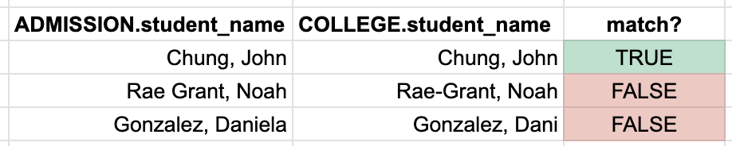
Challenge: Student_name as Primary Key
Challenge
Manually entered student names lack consistency
Use of nicknames vs. legal names.
Alumni who change their maiden name.
Typos or formatting differences
Best practice
Primary keys should:
Be unique integers
Avoid ambiguous identifiers like names
Notes:
The initial phase of this project involved attempting to merge the real databases from Academy X’s Admission and College Offices. A significant issue encountered during this process was that both offices used student_name as a primary key in their spreadsheets. Neither office followed consistent criteria for formatting names, resulting in mismatches between ADMISSION.student_name and COLLEGE.student_name.

Slide 13
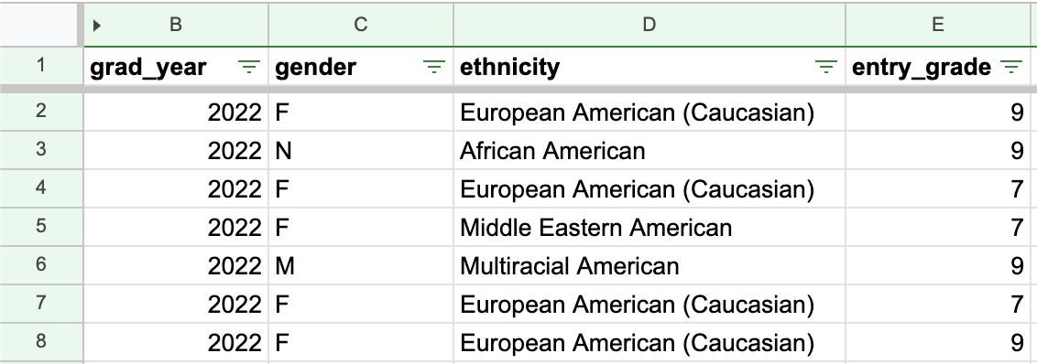
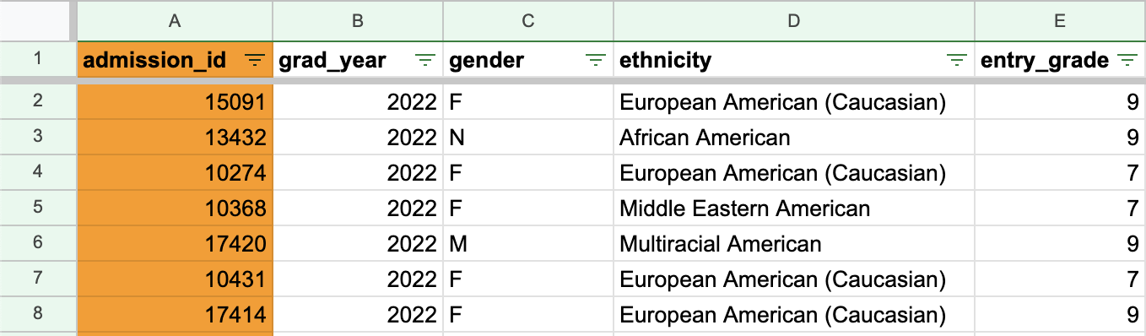
Challenge: Student_name as Primary Key
Solution
Generate integer primary keys for sileod tables
Notes:
Solutions:
Assign integer primary key to COLLEGE OFFICE data ADMISSION OFFICE data
Validate data: try to match by first_name + last_name (accounted for 90% of 536 students).
Use additional identifying data to validate remaining unmatched ids (ex: email, grad year, demographics)
Store student_id, college_id, admission_id in Junction Table to link the siloed tables together
In real-life, both offices retained additional data fields that could be used to validate and reconcile unmatched records, such as:
Email address
Graduation year
Demographics (gender, race/ethnicity, financial aid status)
While we ultimately generated our data for privacy reasons, this issue underscores an important best practice in database design: the use of integer-based primary keys to uniquely identify records. To address similar real-life challenges, leveraging secondary fields for data validation (ie, email and graduation year) is a practical workaround to improve data integrity and ensure successful integration across systems.

Slide 14
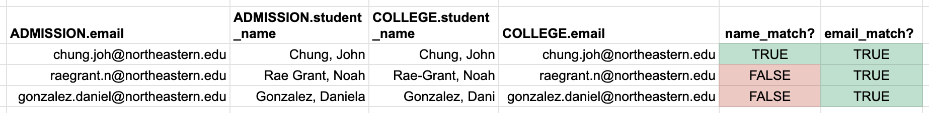
Challenge: Student_name as Primary Key
Solution
Generate integer primary keys for sileod tables
Validate student_ids using secondary data fields
Notes:
Solutions:
Assign integer primary key to COLLEGE OFFICE data ADMISSION OFFICE data
Validate data: try to match by first_name + last_name (accounted for 90% of 536 students).
Use additional identifying data to validate remaining unmatched ids (ex: email, grad year, demographics)
Store student_id, college_id, admission_id in Junction Table to link the siloed tables together
In real-life, both offices retained additional data fields that could be used to validate and reconcile unmatched records, such as:
Email address
Graduation year
Demographics (gender, race/ethnicity, financial aid status)
While we ultimately generated our data for privacy reasons, this issue underscores an important best practice in database design: the use of integer-based primary keys to uniquely identify records. To address similar real-life challenges, leveraging secondary fields for data validation (ie, email and graduation year) is a practical workaround to improve data integrity and ensure successful integration across systems.

Slide 15
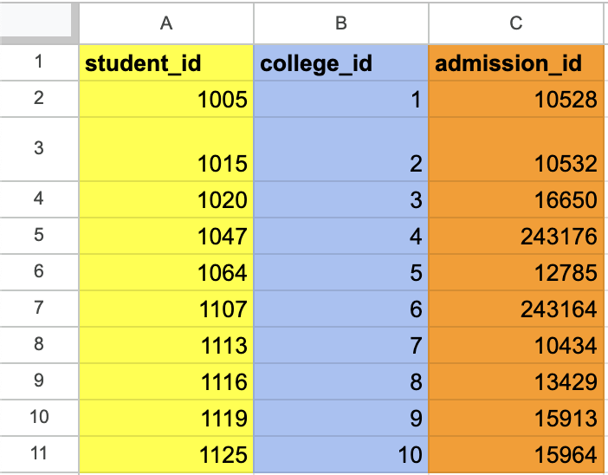
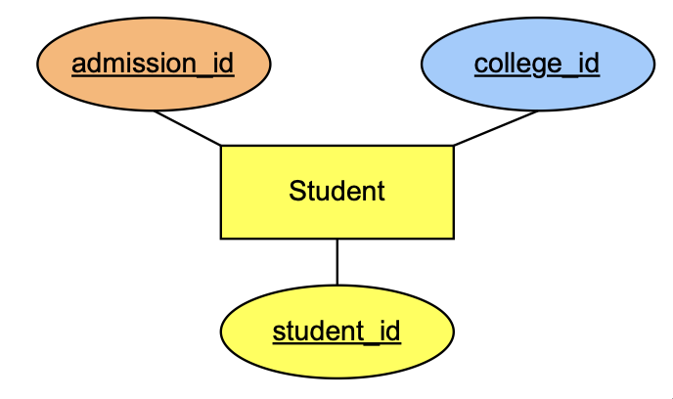
Challenge: Student_name as Primary Key
Solution
Generate integer primary keys for sileod tables
Validate student_ids using secondary data fields
Link siloed tables together in a Junction Table
Notes:
Solutions:
Assign integer primary key to COLLEGE OFFICE data ADMISSION OFFICE data
Validate data: try to match by first_name + last_name (accounted for 90% of 536 students).
Use additional identifying data to validate remaining unmatched ids (ex: email, grad year, demographics)
Store student_id, college_id, admission_id in Junction Table to link the siloed tables together
In real-life, both offices retained additional data fields that could be used to validate and reconcile unmatched records, such as:
Email address
Graduation year
Demographics (gender, race/ethnicity, financial aid status)
While we ultimately generated our data for privacy reasons, this issue underscores an important best practice in database design: the use of integer-based primary keys to uniquely identify records. To address similar real-life challenges, leveraging secondary fields for data validation (ie, email and graduation year) is a practical workaround to improve data integrity and ensure successful integration across systems.

Slide 16

Challenge: Data Privacy & Confidentiality
Challenge
Using real student data without permission would violate Academy X’s data privacy rules.
Best practice
Every institution should have a data governance rules around the access of their data.
Define clear guidelines for data access, sharing, and retention.
Restrict data access using role-based permissions.
Encrypt sensitive data and use secure authentication methods.
Notes:
Independent schools should prioritize:
Institutional Policies: Define clear guidelines for data access, sharing, and retention.
Access Control: Restrict data access using role-based permissions.
Data Security: Encrypt sensitive data and use secure authentication methods.
Protecting student data is an essential responsibility for independent schools. Families entrust institutions to handle sensitive data ethically and securely. Independent schools must define their own governance policies, including role-based access controls and encryption, to safeguard student records. Establishing clear guidelines for data sharing, retention, and regular audits can further reduce risks and ensure ethical handling of information.

Slide 17
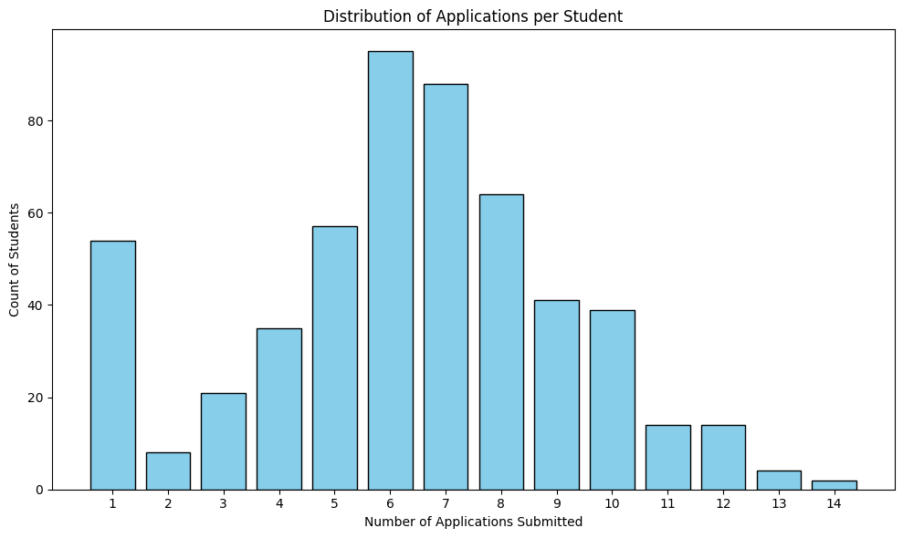
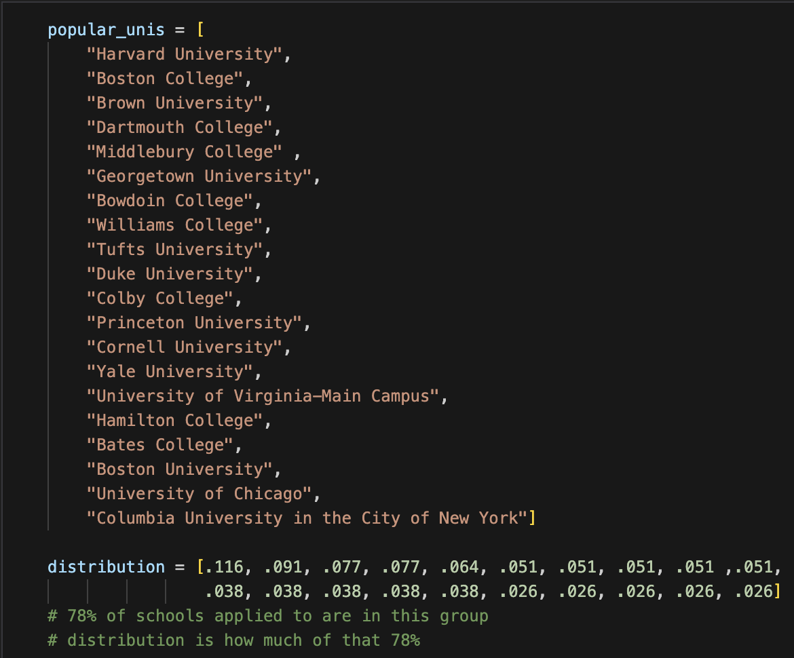
Challenge: Data Privacy & Confidentiality
Solution
For our DS5110 Final Project, we utilized real data fields from Academy X, but generated student data based on assumptions and expected distributions
Notes:
To comply with Academy X’s data governance and privacy policies, real student data was not utilized. Instead, data was generated based on predetermined distribution levels, leveraging the expertise and insights of a group member with connections to Academy X.
For example, the APPLICATIONS table was designed according to the following specifications:
Around 20% of the student body should be recruited athletes who only apply to one university.
The remaining students submit applications to between 1 and 15 unique universities.
The number of applications submitted per student and universities applied to were structured to mimic realistic distributions. Code was developed to generate data satisfying these criteria, incorporating random seeding with preferential bias towards the most popular universities, which represent 78% of applications students submit from Academy X.

Slide 18
Relational Database
With sample queries and visualizations

Slide 19
Unused Slides

